Slide 1


Music Genres Classification Using Machine Learning
Instructed By : Presented By:
Dr. Satyam Agarwal Rohit Rana

Slide 2
INTRODUCTION
Nowadays a huge number of different types of music are released each day. Managing or classifying this huge number of music manually is very difficult.
Machine learning models give the various classification techniques for classification of music into different genres.
we classify into 10 different genres such as Blues, Classical, Country, Disco, Hip-Hop, Jazz, Metal, Pop, Reggae, Rock.

Slide 3
DATASET
All the musical data is obtained from the public GTZAN dataset from Kaggle.
This dataset provides us with 1000 30-second audio clips, all labeled as one out of 10 possible genres.
100 samples of each type that is 100*10 = 1,000 sample data.
Link :- https://www.kaggle.com/andradaolteanu/gtzan-dataset-music-genre-classification

Slide 4
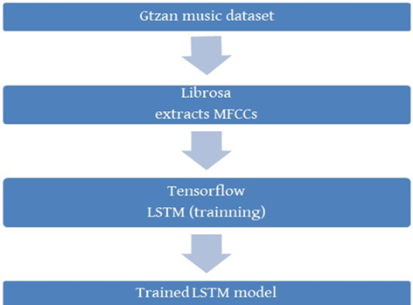
MODEL ARCHITECTURE

Slide 5
ALGORITHM
Preprocessing the dataset : read all the audio files using librosa library and extract features such as MFCC ,spectral centroid, Chroma, Spectral Contrast.
Splitting into train test and validation : used 10 songs for each genre as test examples, 20 songs of each genre as validation set and rest of the example as training set.
Performing the training on the model :used LSTM RNN to train our model and used Adam optimizer to achieve optimum parameter.
Validating the performance of the model : on validation data
Testing the performance of the model : on test data.

Slide 6
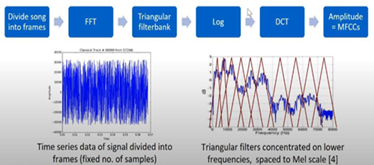
MEL FREQUENCY CEPSTRAL COEFFICIENTS (MFCC)

Slide 7
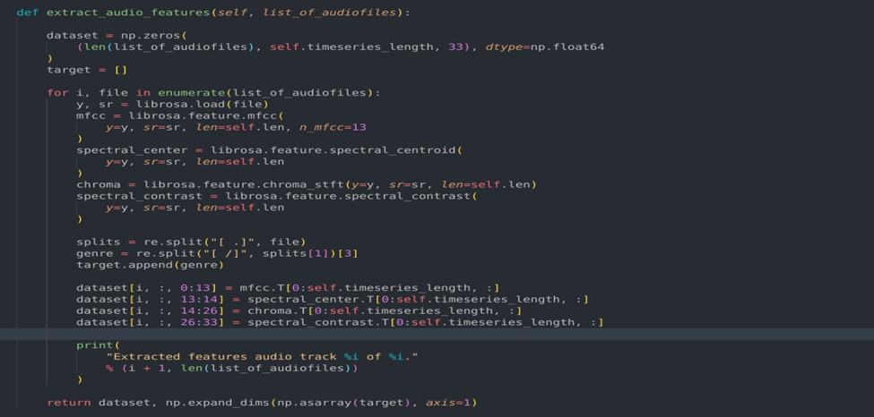
LIBROSSA FEATURE EXTRACT

Slide 8

RECURRENT NEURAL NETWORK
Recurrent Neural Network or RNN's are also known as sequence models that are used mainly in the field of natural language processing as well as some other areas such as speech to text translation, video activity monitoring etc.
RNN is recurrent in nature as it performs the same function for every input of data while the output of the current input depends on the past one computation.
All recurrent neural networks have the form of a chain of repeating modules of neural network.

Slide 9

LONG SHORT TERM MEMORY NETWORK(LSTM)
LSTM is new better part of RNN which overcomes the long-term dependencies problems.
The repeating module in an LSTM contains four interacting layers

Slide 10
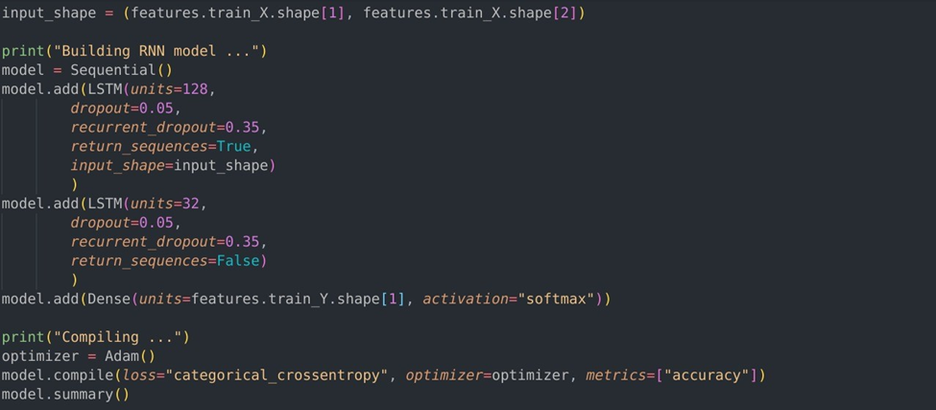
BUILDING RNN(LSTM) MODEL
Preprocessing the dataset : read all the audio files using librosa library and extract features such as MFCC ,spectral centroid.
Splitting into train test and validation : used 10 songs for each genre as test examples, 20 songs of each genre as validation set and rest of the example as training set.
Performing the training on the model :used LSTM RNN to train our model and used Adam optimizer to achieve optimum parameter.
Validating the performance of the model : on validation data
Testing the performance of the model : on test data.

Slide 11
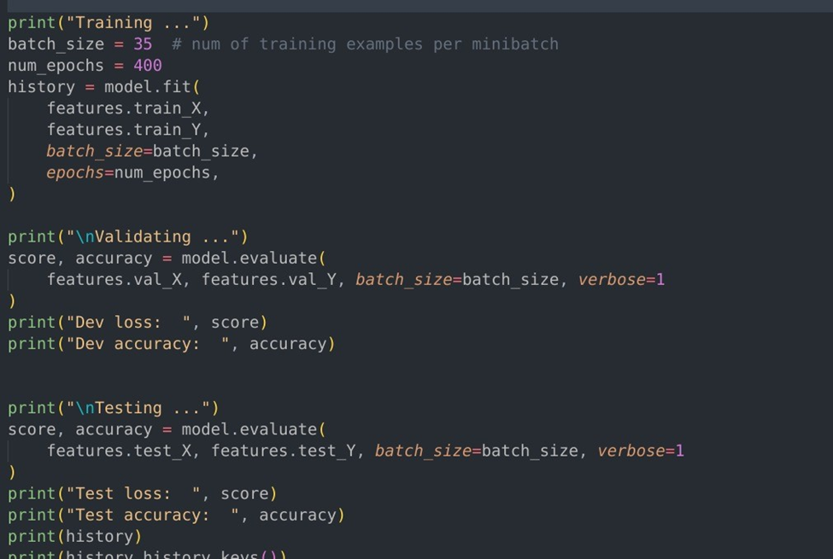
Validating and testing the performance
Preprocessing the dataset : read all the audio files using librosa library and extract features such as MFCC ,spectral centroid.
Splitting into train test and validation : used 10 songs for each genre as test examples, 20 songs of each genre as validation set and rest of the example as training set.
Performing the training on the model :used LSTM RNN to train our model and used Adam optimizer to achieve optimum parameter.
Validating the performance of the model : on validation data
Testing the performance of the model : on test data.

Slide 12
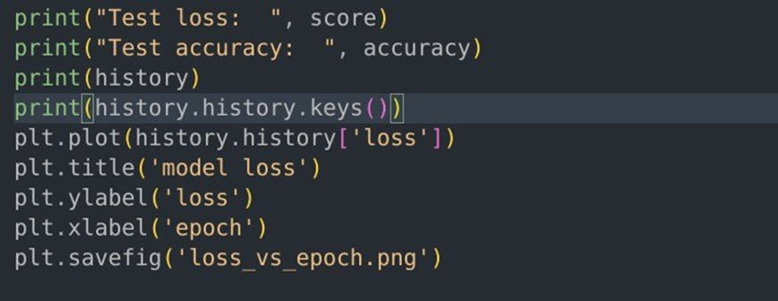
Plotting the graphs for the loss vs epochs and Accuracy vs epochs

Slide 13
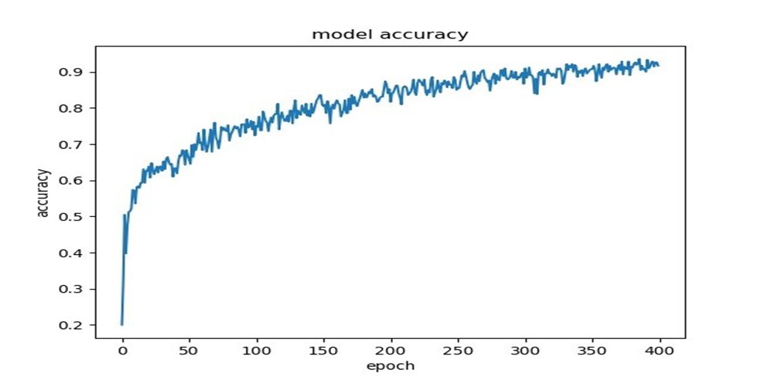
graphs for the Accuracy vs epochs

Slide 14
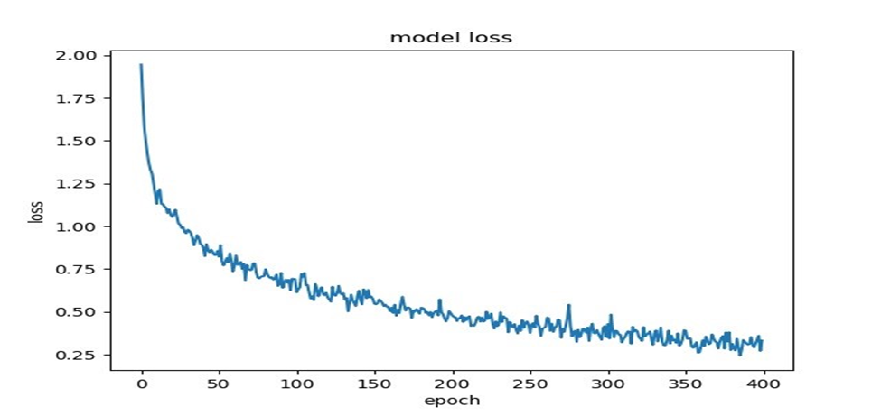
graphs for the loss vs epochs

Slide 15
CONCLUSION
Developed a 10 music Genres classification system.
The accuracy of the simple sequential model increased up to 97%.
LSTM is well-suited to classify, process, and predict time series.
It also performed excellently on the music genres classification.

Slide 16
REFRENCES
G. Tzanetakis and P. Cook. Musical genre classification of audio signals. IEEE Transactions on Speech and Audio Processing,10(5):293–302, July 2002.
Nilesh M. Patil, Dr. Milind U. Nemade,”Music Genre Classification Using MFCC, K-NN and SVM Classifier”, IJCERT, February, 2017.

Slide 17
THANK YOU

